Slide 1

A Story from Pineapple Juice
Yi Chun Wang
Notes:
And two major tools that was developed in ImSol and is used in ImSol. Phantom DB and Paligo

Slide 2
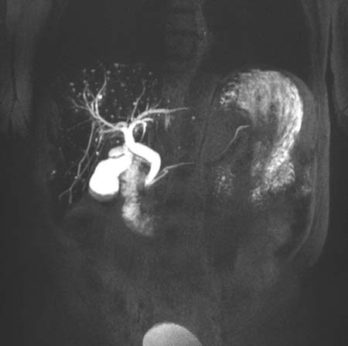
Terminology
cT1: iron corrected T1
PDFF: proton density fat fraction
MRCP: Magnetic Resonance Cholangiopancreatography
Image retrieved from: Radiology.org
Notes:
cT1 is iron corrected T1, it is not T1 itself
PDFF stands for proton density fat fraction and can be used to quantify the fat percentage of a specific organ
MRCP is the procedure which the main anatomic target is the biliary tree
and it is acquired with T2-weighted sequence because the fluid in the bile ducts can serve as intrinsic contrast, but it's usually more complicated

Slide 3
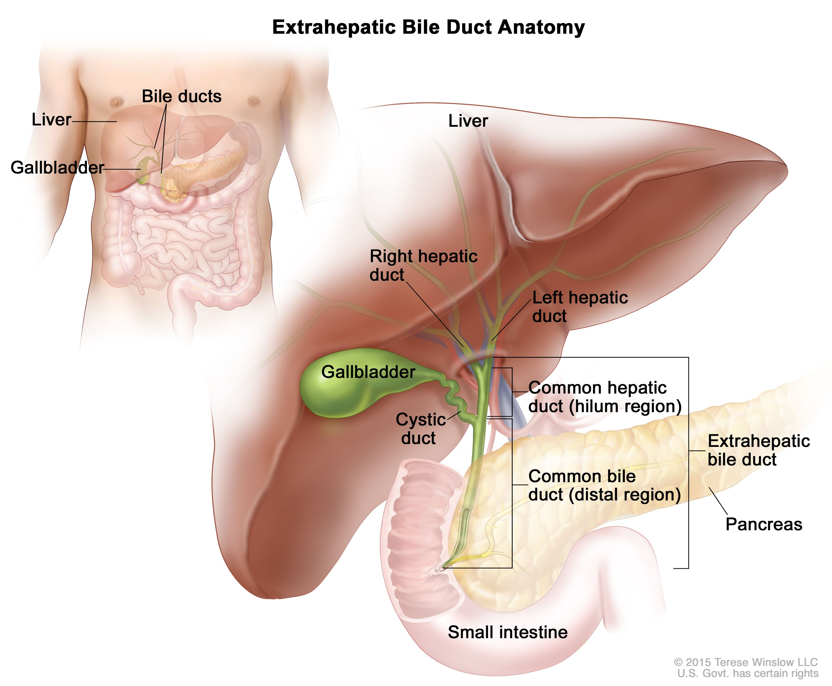
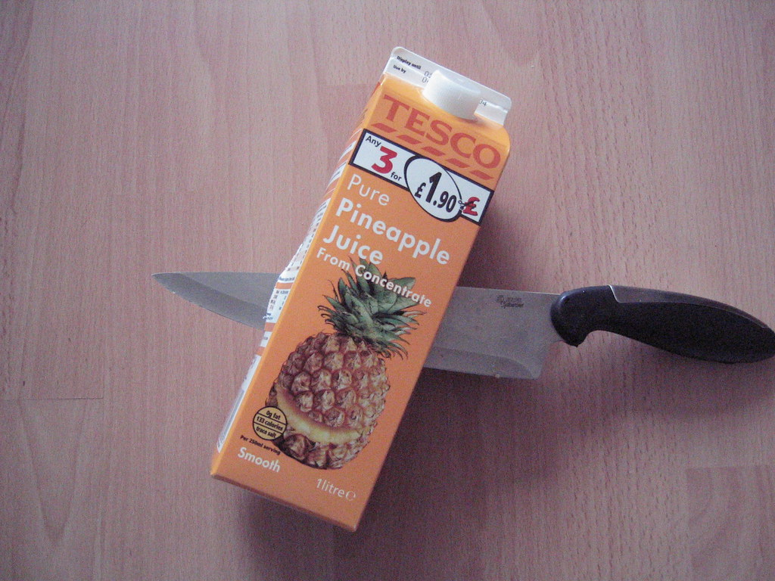
Why pineapple juice?
Manganese(Mn) concentration
pure PJ: 27.6 mg/L
shortened T2 relaxation time → decreased T2 signal intensity →suppress gastric fluid signal from gastrointestinal tract
shown to achieve comparable result as the commercial negative contrast agent: ferumoxsil (Superparamagnetic iron oxide (SPIO))
Notes:
The complicated hepatobiliary system biliary tree grow into the liver along with major vessels like portal vein, hepatic artery and hepatic vein.
You then have the pancreatic duct joining the CBD at the duodenum papillae
So apart from the biliary tree signals, the gastroinstinal tract also contribute the signal. It then because too noisy.
We then want to kill the signal from the bowel by using contrast through oral ingestion.
Superparamagnetic iron oxide (SPIO) = ferric iron (Fe³⁺) + ferrous iron (Fe²⁺) in the general formula of Fe₂³⁺OFe²⁺O.
The iron oxides particles are coated with a layer of dextran or other polysaccharide.
SPIO is used mainly as a T2 contrast agent in MRI though it can shorten both T1 and T2/T2* relaxation processes.
But commercial contrast agent tasted very disgusting and thick.
so scientist commercially available pineapple juice [Mn] ranges from 9.3 mg/L to 12.7 mg/L,
although substantially lower than the 40 mg/L manganese concentration achieved with commercially prepared manganese contrast agents, was shown to be effective for elimination of signal from the digestive tract.
Even though the patient usually had fasted for at least 4 hrs, meaning that peristalsis is neglected.

Slide 4

Motivation is a beautiful coincidence
Does the pineapple juice affect the liver metrics?
If yes, is it to the degree we need to correct for?
Image retrieved from: Radiology.org
Notes:
Internship Pers
first 2 product, 1 of them focus on getting liver metric and the other one focuses on getting biliary system related metric
but because they are 2 different sets of metric. The development goes on it's own path: repeatability, reproducibility and accurate?
So the cross talk between the two are not hugely studied.
However the data is actually available
Goal of this analysis is look at if we are going to introduce pineapple juice at the MRCP side of acquisition, does it affect the live metric. And if yes, is it something we need to correct
Simple question: Does Pineapple juice effect the cT1 - We should know
We asked around, as far as we could go, digged out any report or document on MRCP but there wasn't anything
We found out the data was never analysed, which makes sense that we don't have the answer
This is not on anyone's list right now, how can we answer this min resource as possible?
We had our first study that had MRCP and cT1 acquisition in the protocol.
The customers asked the simple question of : We thought there was an answer, turns out there isn't
The data has been acquired but never analysed !
We had the chance to take advantage of our automatic pipeline, the investigation was done with min resource involvement
Does the pineapple juice change the biomarkers in relations to the recommended reference range?
Do we have a way to rule out the difference is because of measurement error?\
Children 5-15
A selection of image method
They have MRCP + LMS
We had not have this combination before
We want to work out
You would expect we know the answer
We dig out
But unfortunately, we acquired data bur never did the analysis
But thankfully,

Slide 5
Method
30 volunteers
Healthy
with hepatobiliary condition
with liver condition
Scanner Manufacturer | Hardware Software Addition | Field Strength | Site | Acquisition | Pineapple Juice | N
Siemens | Prisma, E11C MyoMaps | 3T | OCMR, Oxford | 2 scans (on-off-on) | 400ml of PJ 20 minutes prior to 2nd scan | 17
Siemens | Avantofit, E11C MyoMaps | 1.5 T | OCMR, Oxford | 2 scans (on-off-on) | 400ml of PJ 20 minutes prior to 2nd scan | 13
Imaging Processing with LiverMultiScan (retrieve metrics: cT1, PDFF, Iron from T2*)
Distribution, Trend visualisation, Paired Tests, Bland Altman Analysis
Notes:
The image processing part will be the part I will look into more in detail
loadAndProcessWithAutomation.m run batch analysis overnight
The MRI protocol included a multi-echo spoiled-gradient-echo chemical shift encoded acquisition to calculate T2* and PDFF maps in most cases, although some PDFF values were generated using in vivo proton magnetic resonance spectroscopy (MRS), a specialized magnetic resonance technique that measures fat by quantifying the overall volume fraction of lipids in the liver parenchyma.
A ShMOLLI sequence was used to derive T1-relaxation.
Iron was calculated from the T2* relaxation.
To generate cT1 maps, the acquired MOLLI image data were fit using a Bloch equation simulation approach. The resultant cT1 maps were generated according to the latest LiverMultiScan® post-processing algorithms that reflect a measurement that would be expected if the patient had been scanned with a heart rate of 60 bpm, with normal liver iron and on a Siemens 3T scanner.

Slide 6
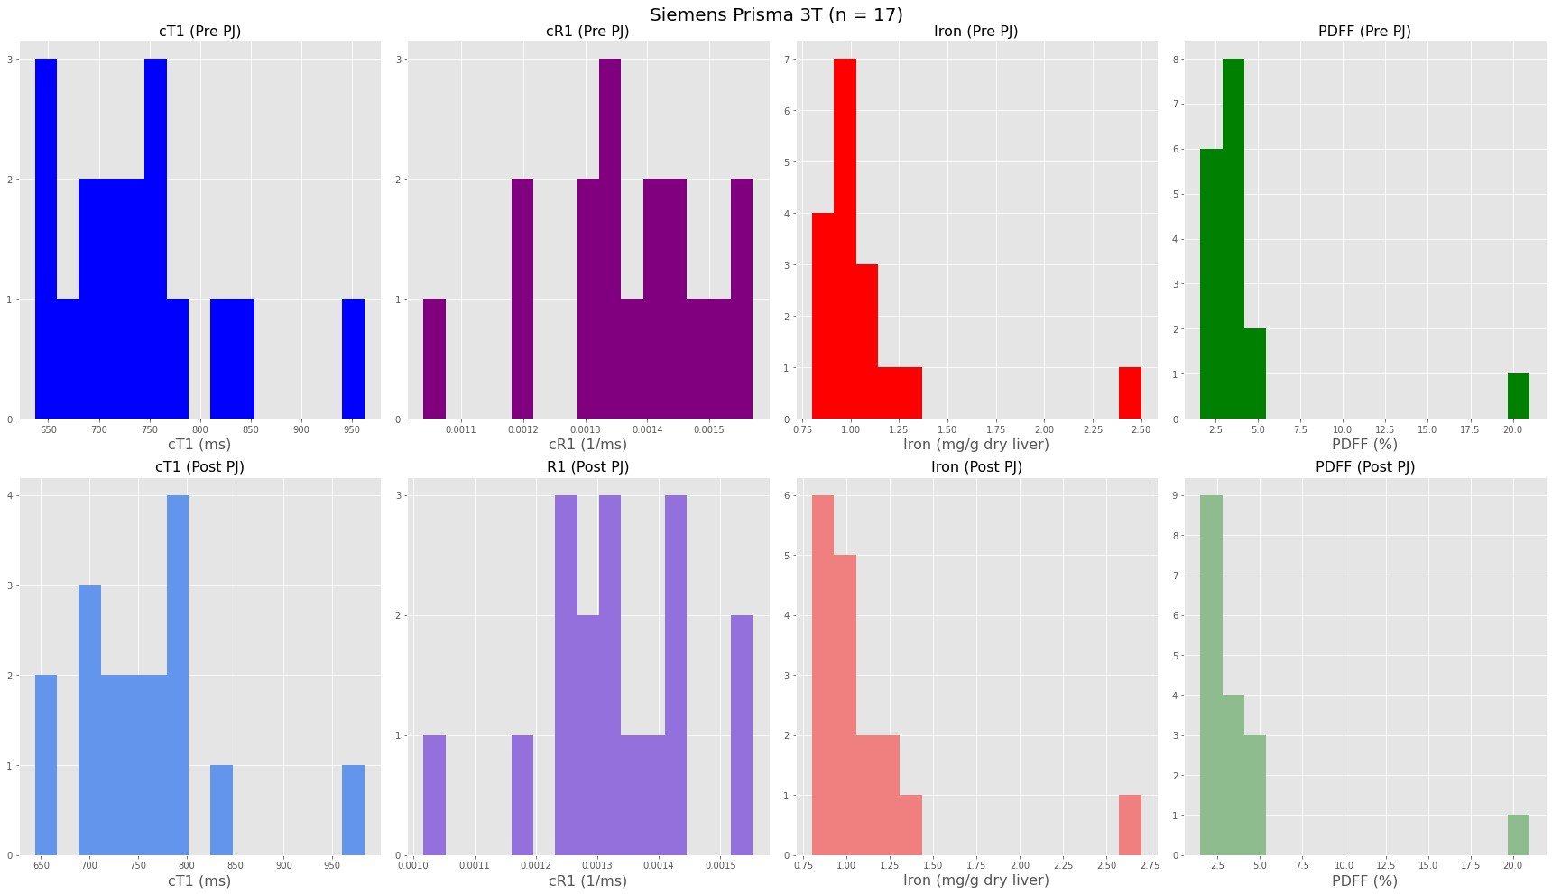
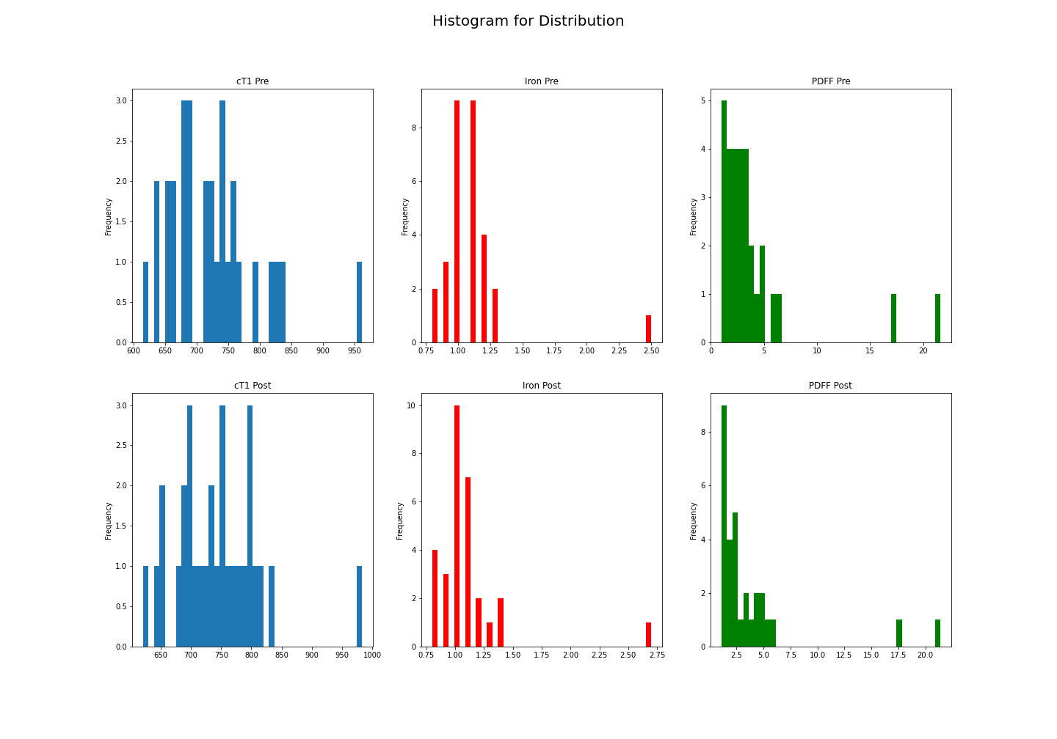
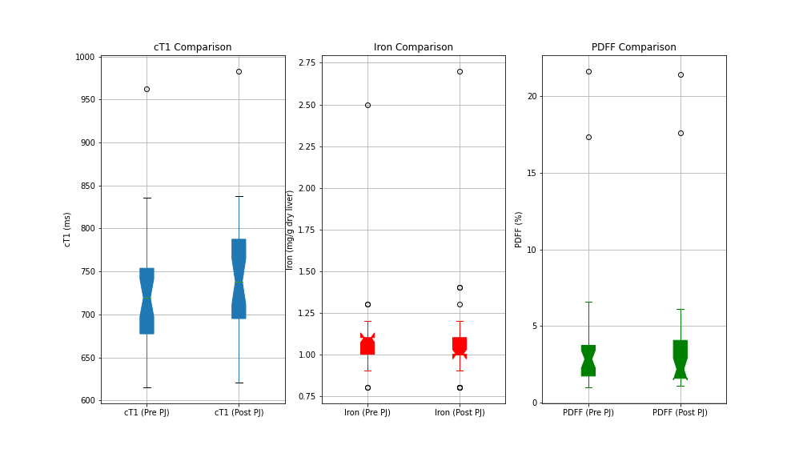
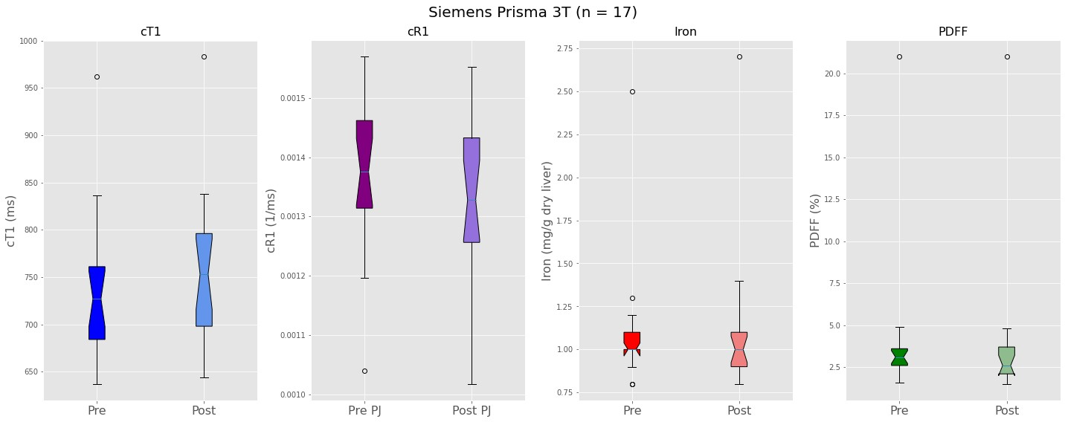
Explore the distribution

Slide 7
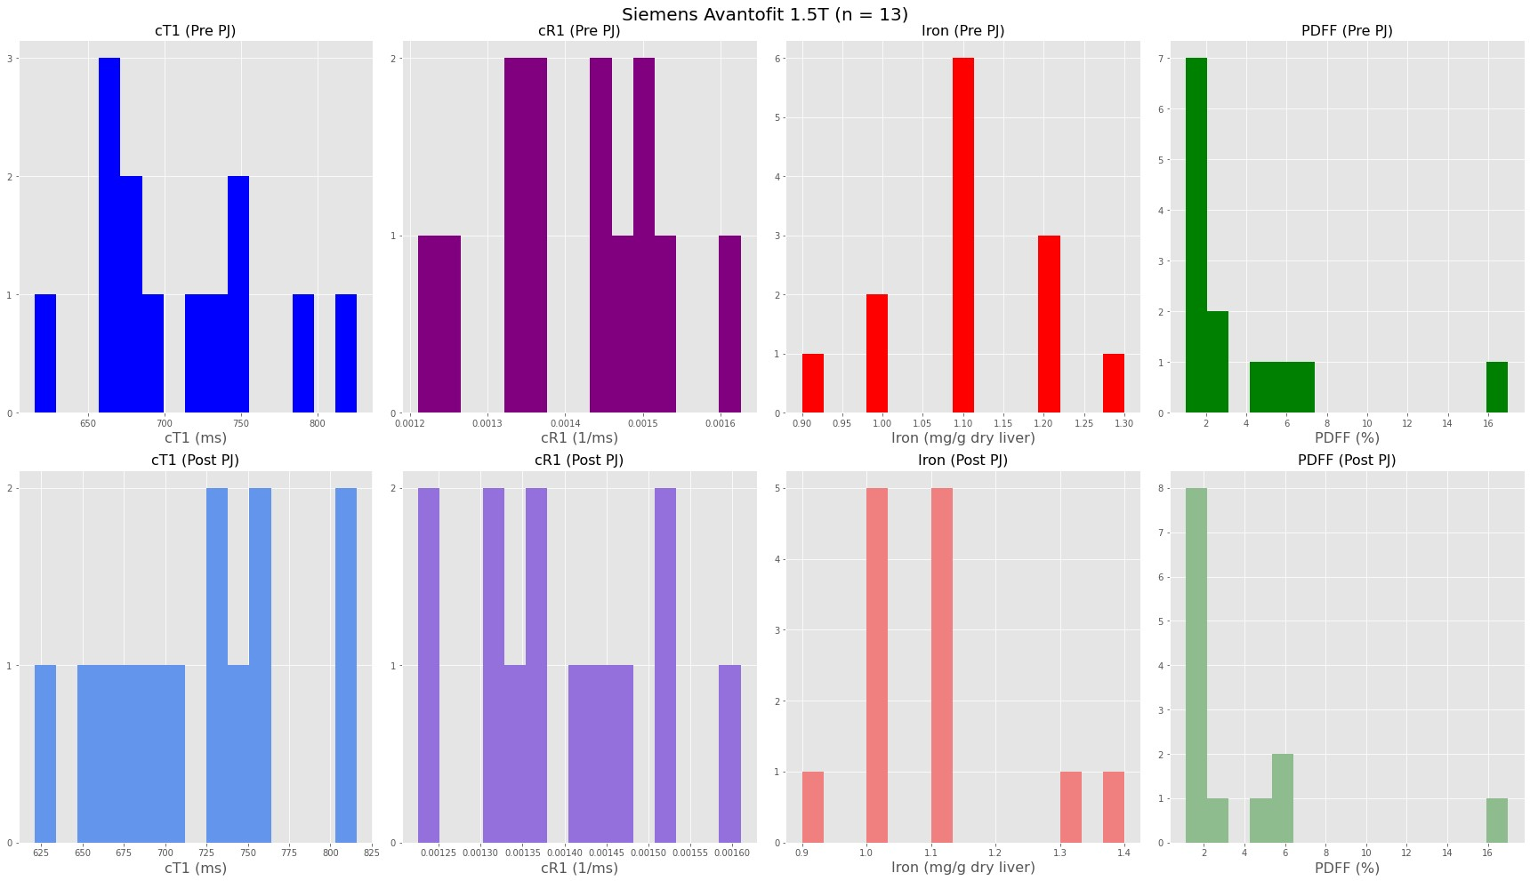
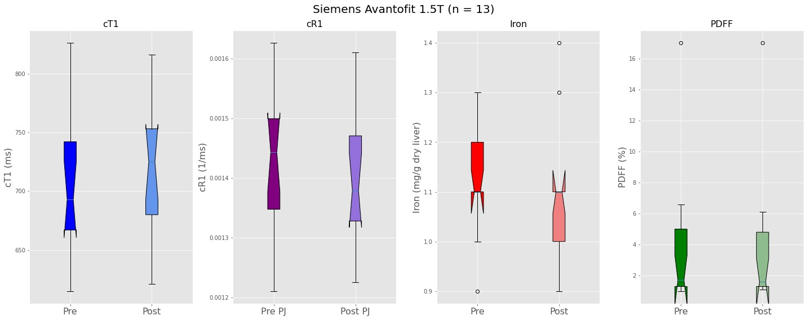
Explore the distribution

Slide 8
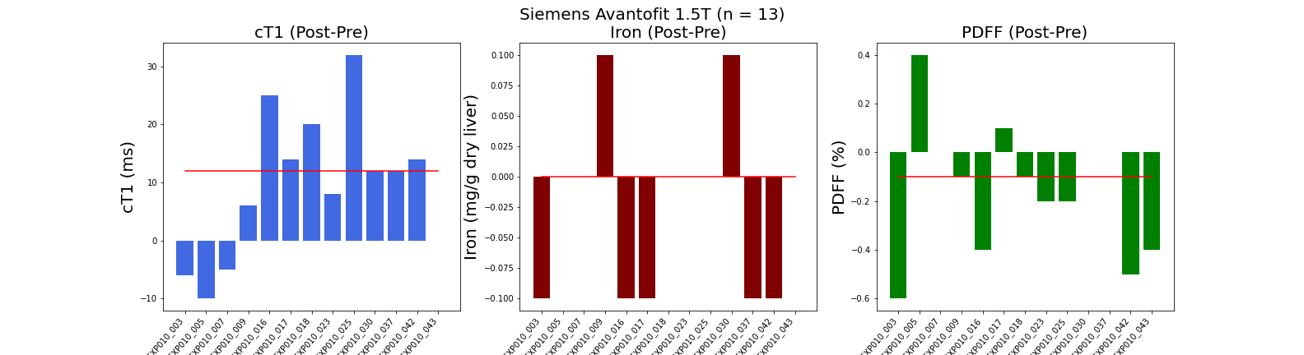
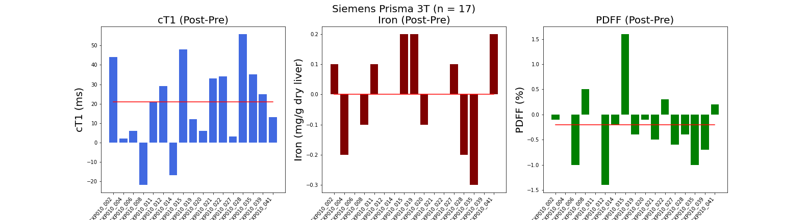
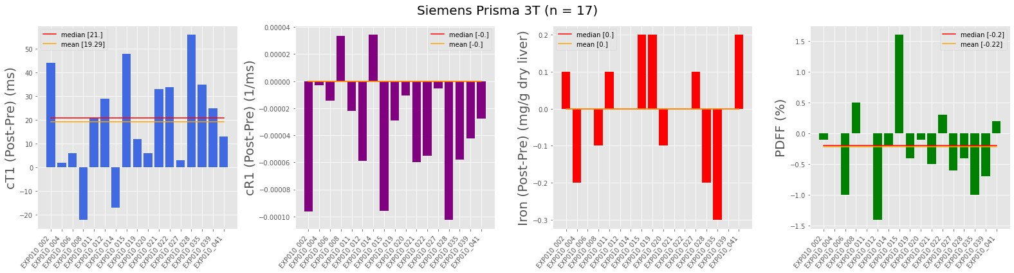
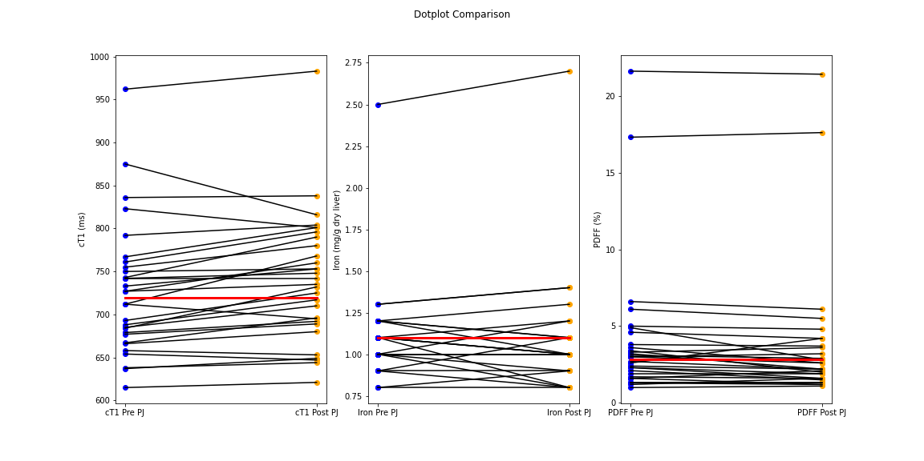
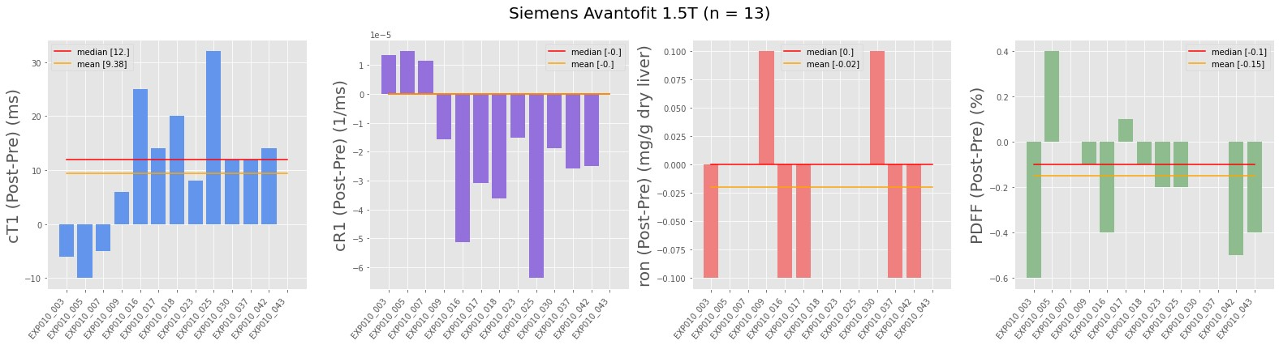
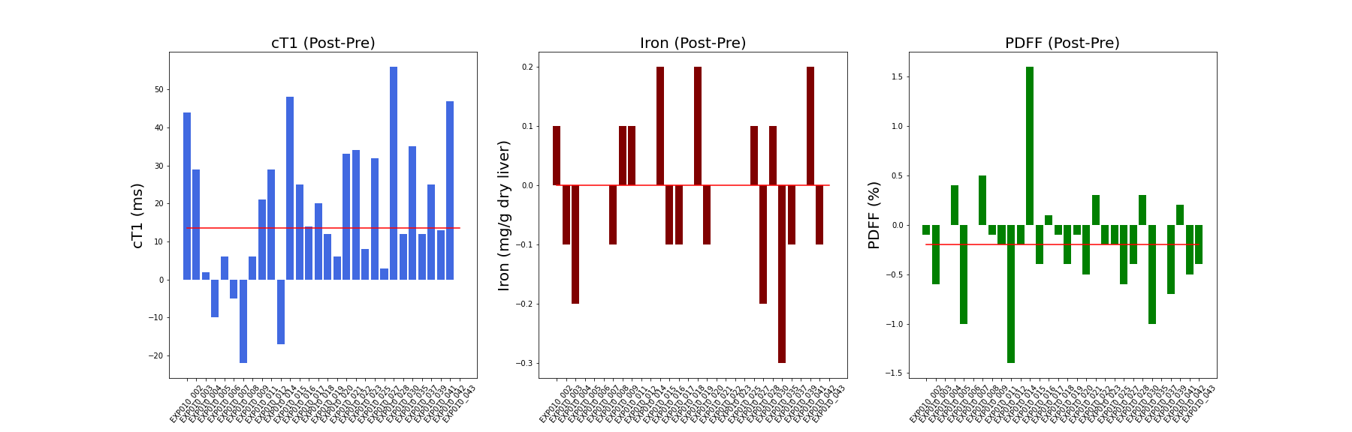
Let’s look at the trend
3T
1.5T
0.0
13.5
-0.1999
Notes:
This plots is meant to show the trend of the biomarkers change after PJ administration.
the blue dots on the left is the pre and orange dots represent the post.
The red line indicates the median for for the individual distribution.
I then use the lines to connect the dots of pre and post results, but it doesn’t seem to have a huge difference.
So the other way, which I probably should've done as the first attempt.
Each bar here in the plot represent the delta of that metric
and the red line is the average of the delta
We need to know this to decide whether we use one-sided or 2 sided paired test

Slide 9
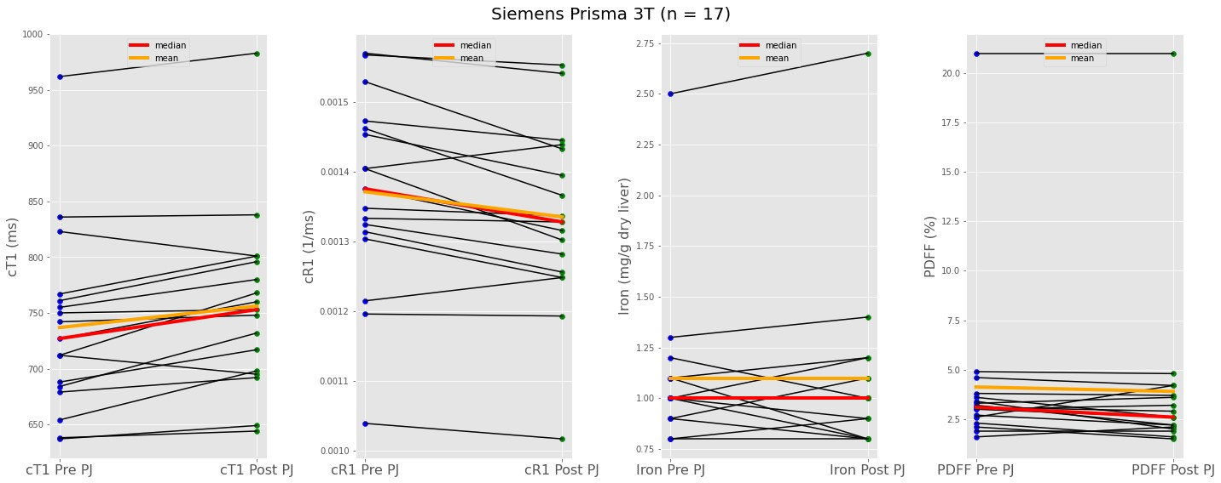
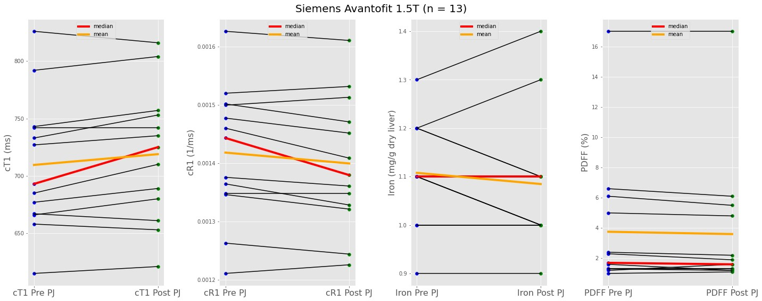
Let’s look at the trend
3T
1.5T
0.0
13.5
-0.1999
Notes:
This plots is meant to show the trend of the biomarkers change after PJ administration.
the blue dots on the left is the pre and orange dots represent the post.
The red line indicates the median for for the individual distribution.
I then use the lines to connect the dots of pre and post results, but it doesn’t seem to have a huge difference.
So the other way, which I probably should've done as the first attempt.
Each bar here in the plot represent the delta of that metric
and the red line is the average of the delta
We need to know this to decide whether we use one-sided or 2 sided paired test

Slide 10
T test + Wilcoxon Rank Test
Field Strength | Metric | Pre-PJ | Post-PJ | Paired Test* (p value)
3T | cT1 (ms) | mean = 736.9 | mean = 756.2 | TT (p = 0.002)
3T | CR1 (1/ms) | mean=1.36*10⁻³ | mean=1.32*10⁻³ | TT (p = 0.002)
3T | Iron (mg/g dry liver) | median = 1.0 | median = 1.0 | WT (p = 1.0)
3T | PDFF (%) | median = 3.1 | median = 2.6 | WT (p = 0.111)
1.5T | cT1 (ms) | mean = 709.5 | mean = 718.9 | TT (p = 0.018)
1.5T | CR1 (1/ms) | mean =1.41*10⁻³ | mean =1.39*10⁻³ | TT (p = 0.017)
1.5T | Iron (mg/g dry liver) | median = 1.1 | median = 1.1 | WT (p = 0.259)
1.5T | PDFF (%) | median = 1.7 | median = 1.5 | WT (p = 0.074)
*TT = paired two-sided T test, WT = Wilcoxon Signed Rank test
Notes:
The cT1 changes post PJ administration were statistically significant at both 1.5T data (p = 0.018) and 3T data (p = 0.002).
For Iron, there were no changes found at both 1.5T data (p = 0.25) and at 3T data (p = 1.0).
The Wilcoxon Signed Rank test showed the changes in PDFF post PJ administration were not statistically significant at both 1.5T and 3T.

Slide 11
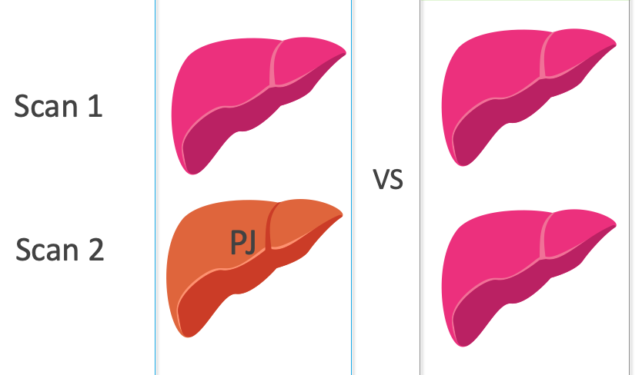
Really or Random?
Pineapple Juice
Experiment
Repeatability
Experiment
Is the changes of cT1 to the degree we need to correct for?
Notes:
In order to answer the second question which is that is the changes of cT1 is to the degree that we need to make correction for under special cases where patient had been scanned with pineapple juice ingestion.
To do this, we can pull another set of data which is that the repeatability experiment and that basically means each participant were having two consecutive identical scans.
So I tried to the best I could to make sure that these people scanned for the pineapple juice experiment were drawn from the repeatability experiment as well

Slide 12
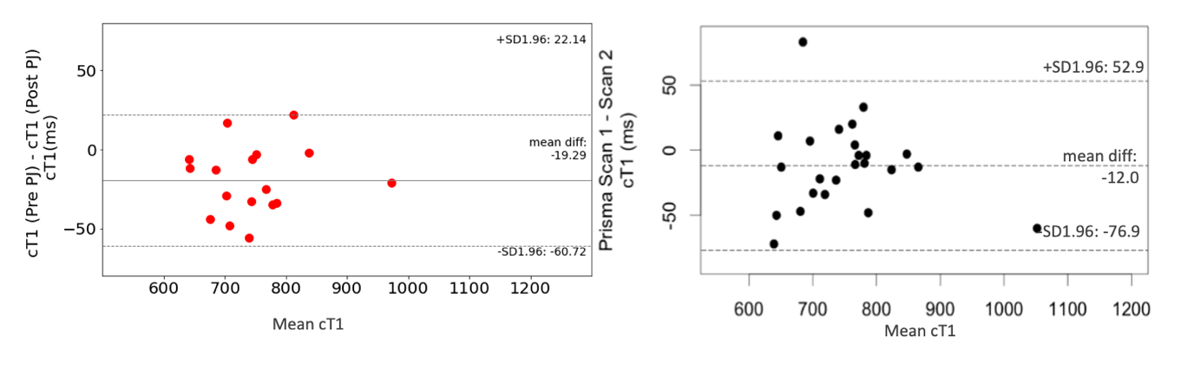
Pineapple Juice
Experiment
Repeatability
Experiment
Really or Random?
Bland-Altman plot of the metric cT1 acquired with 3T scanner for PJ experiment(left) and RP experiment (right)
Notes:
And let’s have a look at the 3T data, it also shows the same patent

Slide 13
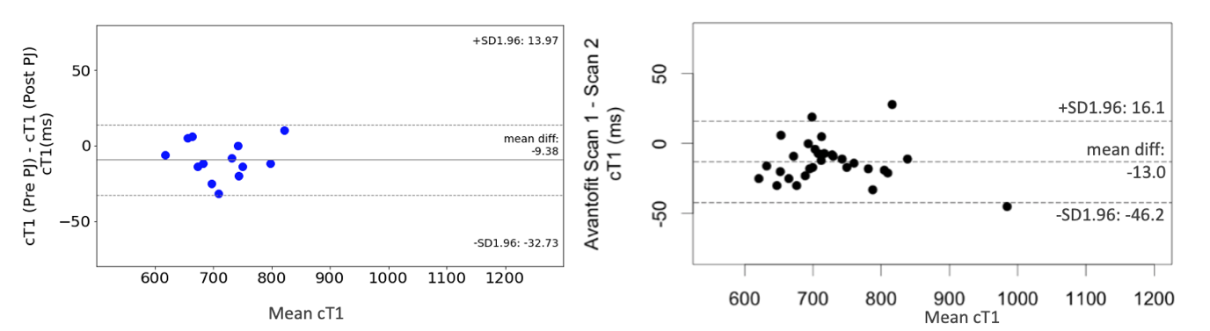
Really or Random?
Pineapple Juice
Experiment
Repeatability
Experiment
Bland-Altman plot of the metric cT1 acquired with 1.5T scanner for PJ experiment(left) and RP experiment (right)
Notes:
The way to look at bland altman analysis is that the delta is plotted against the mean of the paired difference.
And this is a way for us to visualize whether there is systematic error OR whether the two sets of intervention will agree with each other’s results.
If we propagate through a wider range of mean, we can start to see the trend.
Bland Altman analysis is a way for us to visualize (left) whether the two sets of intervention will agree with each other’s results OR (right) whether there is systematic error.
And then let me mention the dotted lines here represent +- 2 standard deviation from the differences mean.
And in the repeatability setting usually you will set a limits of agreement which allows you to judge that, ok any dataset that falls within this range is because of measurement variation and we can not do much about it.
So let’s have a look at the 1.5T data
The available data points we have all falls within the +- 2 SD range however it is not the case for the repeatability experiment
And from visually looking at the data points here, they don’t really show a trend meaning either above or below the differences mean

Slide 14
Discussion: cR1 is more appropriate than cT1
The information of cR1 was derived from taking direct reciprocal from the cT1 value. The reason of deriving this value it to address the phenomenon that initial T1 was found to correlate with delta T1 (change in T1). However this phenomena was not found in R1 (reciprocal of T1 ) values. Please refer to Bluemke, E, Stride, E, Bulte, DP. A simplified empirical model to estimate oxygen relaxivity at different magnetic fields. NMR in Biomedicine. 2022 for more information.
The graphs in the next page show that the scale of plotting can affect the interpretation of final results. The top and bottom rows are same scatter plots with linear regression correlation coefficient. The only difference is the scale of the horizontal and vertical axis. At the top row, the scale of the plot was manually adjusted; at the bottom row, the scale of plots were automatically adjusted to the dataset by Python. The top row showed that the change in cR1 showed to correlate with initial cR1 but changes in cT1 do not correlate with initial cT1. However, the bottom row showed no visible correlation. Interpreting results based on cR1 allow researchers to reduce the confounding effect of the baseline status of the participants’ liver metrics.
However, we would also like to point out the fact that the linear correlation coefficients demonstrated in graphs below did not show strong correlation between the changes in cT1 and initial cT1. This can be due to the fact cT1 scale measured in this pineapple juice experiment, comparing Bluemke et al.'s work, is very small. Therefore, future work should aim to include a much larger range of liver metrics from in-vivo participants.

Slide 15
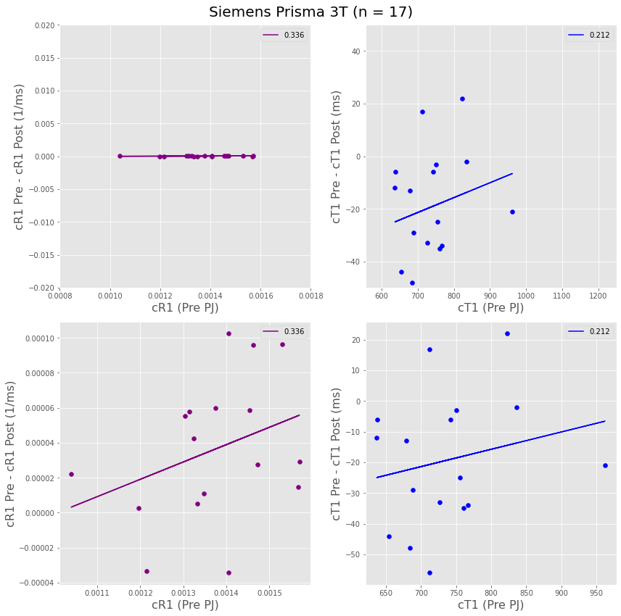
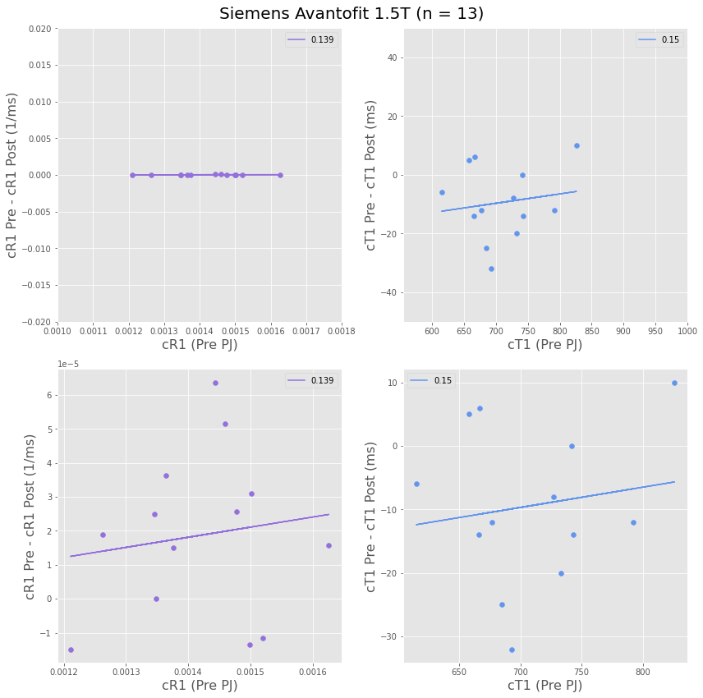
Discussion: cR1 is more appropriate than cT1

Slide 16
Limitation 1 The sample size is too small
Even though pulled analysis also did not show the pineapple juice gave significant impact on the differences of
metrics pre and post. There were less than 20 subjects for each arm of field strength. It is also difficult to conduct TOAST test to define effective size of participant to collect because, to perform TOAST test, a sound experience with the question of interest is needed to decide the alpha value to discriminate between results from the TOAST test.
Future studies should include more participant and conducted an equivalent test to justify for sample size.
Total Scanned participants
20 healthy volunteer
10 with hepatobiliary condition
10 with liver condition
Analyzed Participant
15 healthy volunteer
7 with liver condition
8 with hepatobiliary condition
Outlier Removal
15 healthy volunteer
7 with liver condition
8 with hepatobiliary condition
Exclude: incomplete data
Remove outliers

Slide 17
Limitation 2 Non control of quantification
The final conclusion drawn by collectively considering pineapple juice experiment and repeatability experiment showed that the changes found in pineapple juice dataset is smaller than the measurement variation and therefore it is not clinical relevant. Even though the
The acquisition of the datasets for both repeatability and pineapple juice experiments were acquired roughly around the same time. However, the derivation of the metrics were conducted at different timepoints.
In repeatability experiment (2018), the metrics were derived from trained analysts, manually segmenting out liver in acquired slices. The processing was done in a blinded manner with the medical device LiverMultiScan version 3. In the pineapple juice experiment, metrics derivation was done automated process of segmentation, artefact detection and slice selection for quantification. Although the performance of the automatic processing algorithm was internally validated (achieve human-comparable robustness and judged by dice similarity score [DSC]). The variation found between human analysed case and automatically generated case is inevitable.
Future studies should be careful at designing analysis method. Ideally, the analysis mechanism should be the same. If not possible, re-analysis of repeatability experiment can be conducted to further improve the reliability of the drawn conclusion.

Slide 18
Limitation 3 Inhomogeneous participant
The participant population comprises healthy volunteers, patients with liver disease but no biliary disease, and patients with biliary disease. Note that the reason for including both patient and volunteer data is to assess the full dynamic range of pineapple juice's effect on liver metrics (cT1, cR1, iron and PDFF). Note that the use "outliers" means that the quantified metric values fall outside the distribution of the acquired data. It does not necessarily mean it is caused by disease. However, the subgroup (pulling a set of participant for pineapple juice experiment) lead to a very small sample size. With outliers presented in the pineapple juice experiment dataset, the disease status drastically skew the distribution of measured metrics and therefore makes it difficult to draw solid conclusion.
In the following section, 3 cases were specifically extracted as the outliers identified in this pineapple juice experiment with z-score analysis and graphic inspection(bar plots and box plots). They were all patients with confirmed non-alcoholic fatty liver disease(NAFLD) or non-alcoholic steatohepatitis (NASH) conditions.
Note that the use "outliers" means that the quantified metric values fall outside the distribution of the acquired data. It does not necessarily mean it is caused by disease. Future studies can include a higher number of confirmed NAHS/NAFLD patients to more reliably filter out disease status’ confounding effect and to draw better conclusion of pineapple juice’s direct impact on liver metrics.

Slide 19
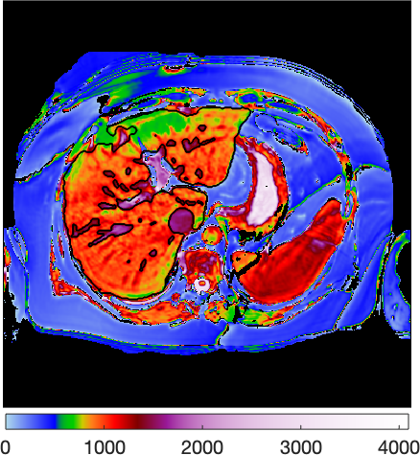
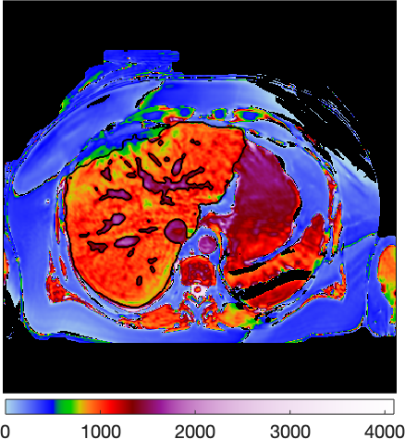
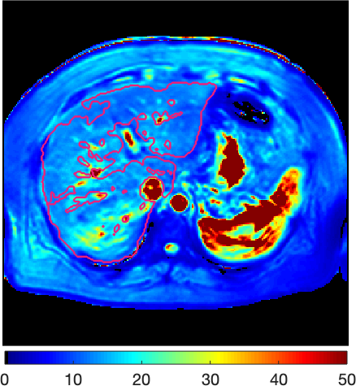
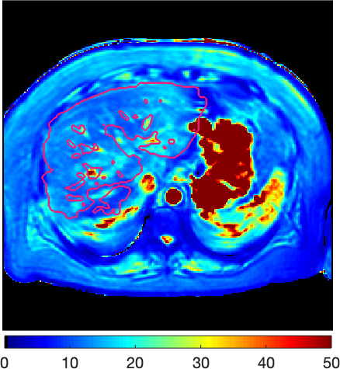
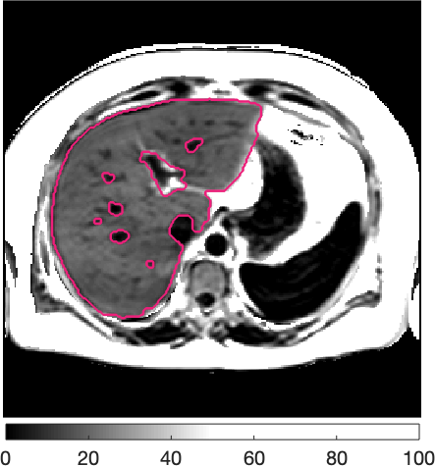
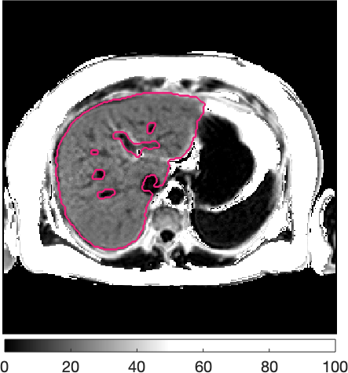
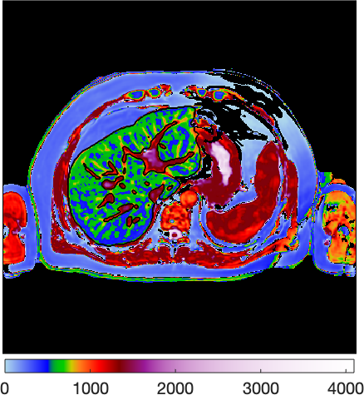
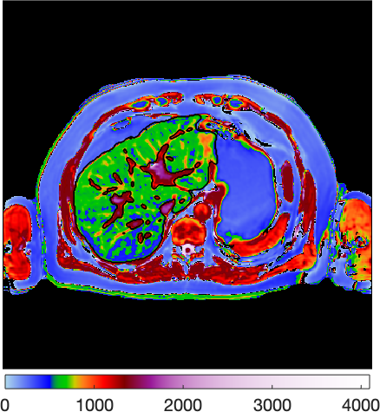
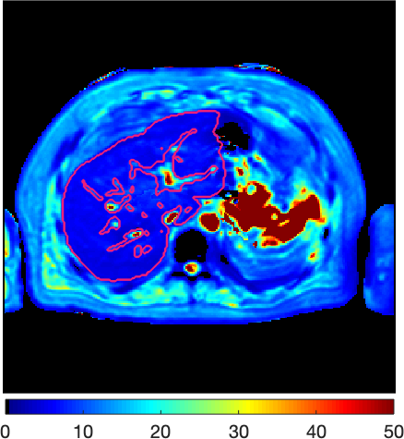
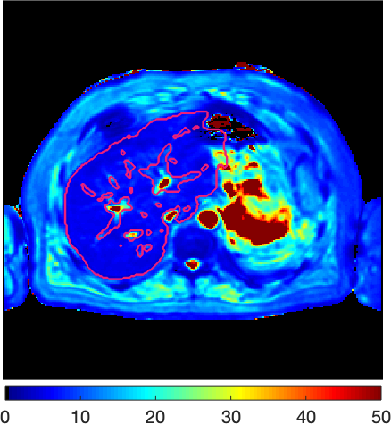
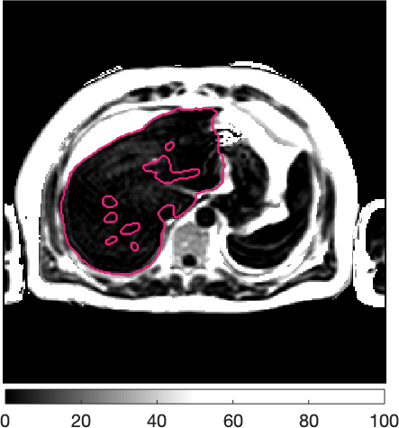
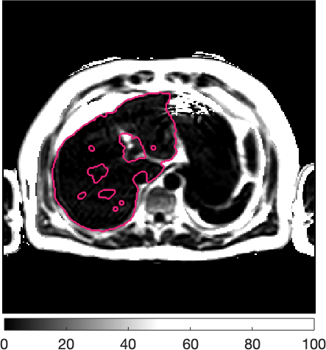
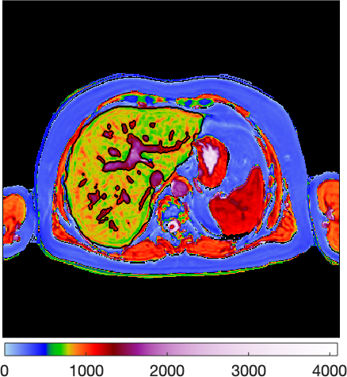
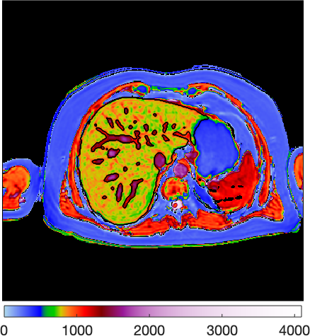
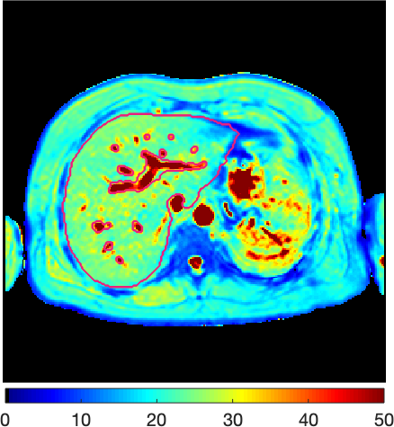
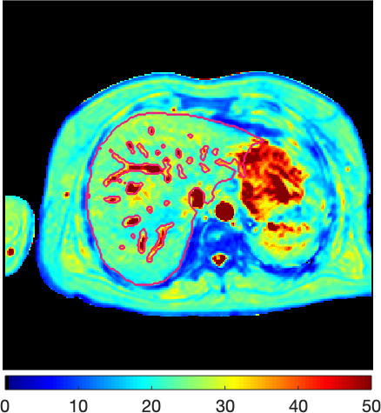
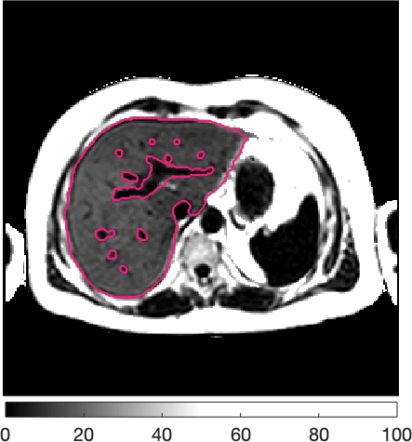
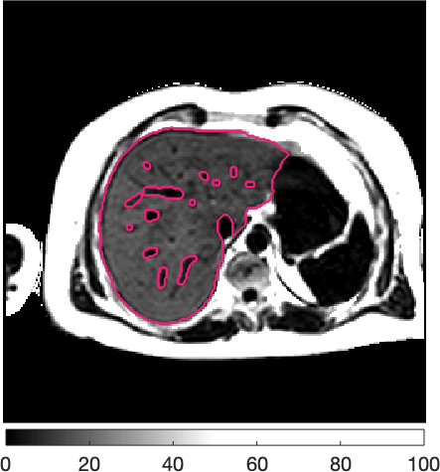
Limitation 3 Inhomogeneous participant
cT1 Pre PJ
cT1 Post PJ
T2* Pre PJ
T2* Post PJ
PDFF Pre PJ
PDFF Post PJ
Case 1 (3T):
Age 34
BMI 35.92 (kg/m²)
Case 2 (3T):
Age 57
BMI 27.99 kg/m²
Case 3 (1.5T): Case Age 39.0
BMI 28.66 kg/m²
Notes:
Tunnicliffe E. Evaluating liver fibrosis in the presence of elevated iron using MR relaxometry. In: UK Provisional Patent No. 1304728.7 filed on 15th March; 2013.
Provided the quantification of iron from T2*

Slide 20
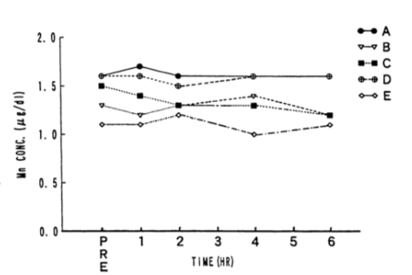
Future Work
Continual recruitment to increase sample size
Exclude confounding effect from disease status
Exclude confounding effect from hydration and iron
The direct effect of manganese on T1 without confounding of water, iron?
Mn is expected to reduce both T1 and T2, the cT1 measured increase instead of decrease
Total of 18mg manganese ingested,
Blood sample drawn at 1h, 2h, 4h and 6h after PJ
Notes:
Manganese is eventually taken up by the liver and other tissues, but the mechanism of this process is not well understood [Office of Dietary Supplements - Manganese. https://ods.od.nih.gov/factsheets/Manganese-HealthProfessional/.]
Hiraishi, K et al. :orally administered fruit juices are poorly absorbed and do not significantly elevate serum concentrations
The Pineapple juice reduce both T1 and T2 signal because of Mn. A non-corrected T1 quantification will be needed to confirm that the reduction of T1 and T2 signal from PJ is not linear relation given that the correction is linear
Could the difference also be caused by the disease status?
Phantom scan is needed to confirm
Further study is needed to flag the participants’ demographic and health status
Test repeatability and reproducibility to be designed
Do we have existing data in other R&R study available?
After the participant had pineapple juice:
(1) Repeatability: scanned twice on same scanner, with a file apart.
Need to work out the half time of Mn injection
(2) Reproducibility for (1): scanned twice on different manufacture but same filed strength

Slide 21
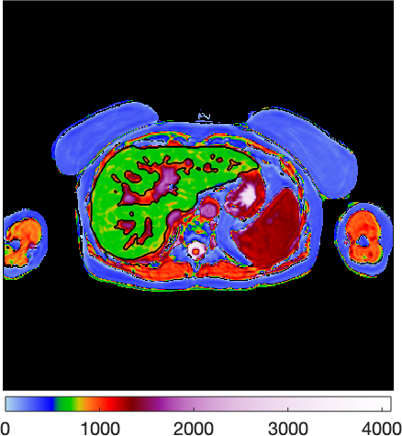
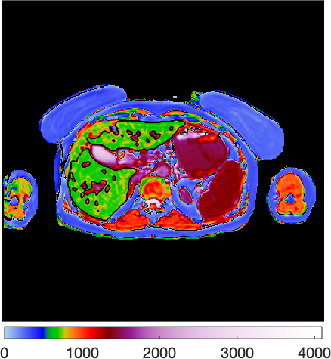
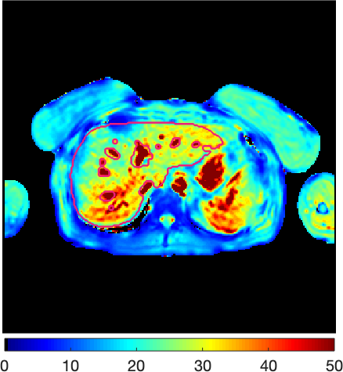
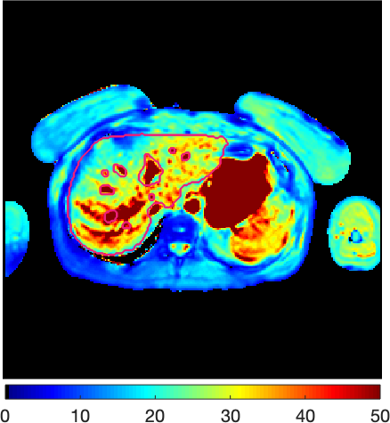
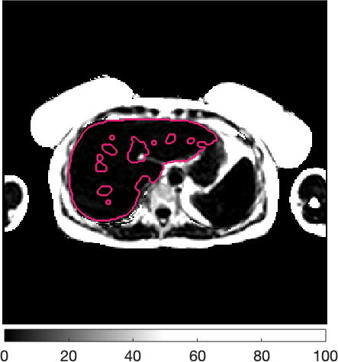
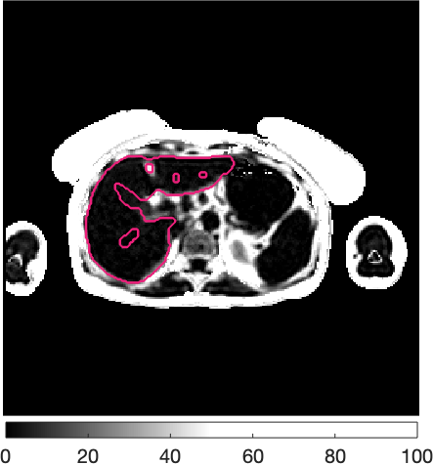
Conclusion
The effect on liver cT1 introduced by pineapple juice is neglectable given the found larger measurement uncertainty (repeatability)
cT1 Pre PJ
cT1 Post PJ
T2* Pre PJ
T2* Post PJ
PDFF Pre PJ
PDFF Post PJ
Rep (3T):
Case EXP010_021 Healthy Volunteer
Rep (1.5T):
Case EXP010_016 Healthy Volunteer
Notes:
Since the difference between the compared data was whether the participant had ingested pineapple juice before the 2nd scan. We can conclude that the pineapple juice does not affect our cT1, T2* and PDFF quantification. The image with metric maps shows similar color before and after pineapple juice ingestion. The images showed is a representative case (EXP010_016).

Slide 22
References
Radiopedia: Gasterointestinal MRI Contrast Agents
Mohabir, Sheryl et al. “The efficacy of pineapple juice as a negative oral contrast agent in magnetic resonance cholangiopancreatography.” SA journal of radiology vol. 24,1 1875. 29 Jul. 2020, doi:10.4102/sajr.v24i1.1875
Alshehri, Fahad Mohammed Ali. “Comparative study of pineapple juice as a negative oral contrast agent in magnetic resonance cholangiopancreatography.” Journal of clinical and diagnostic research : JCDR vol. 9,1 (2015): TC13-6. doi:10.7860/JCDR/2015/10240.5463
Hiraishi, K et al. “Blueberry juice: preliminary evaluation as an oral contrast agent in gastrointestinal MR imaging.” Radiology vol. 194,1 (1995): 119-23. doi:10.1148/radiology.194.1.7997537
Bachtiar V, Kelly MD, Wilman HR, Jacobs J, Newbould R, et al. (2019) Repeatability and reproducibility of multiparametric magnetic resonance imaging of the liver. PLOS ONE 14(4): e0214921. https://doi.org/10.1371/journal.pone.0214921
Dennis, Andrea, Matt D. Kelly, Carolina Fernandes, Sofia Mouchti, Jonathan A. Fallowfield, Gideon Hirschfield, Michael Pavlides, et al. 2021. ‘’Correlations Between MRI Biomarkers PDFF and CT1 With Histopathological Features of Non-Alcoholic Steatohepatitis’’. Frontiers in Endocrinology 11 (January): 575843. https://doi.org/10.3389/fendo.2020.575843.
Riordan, R D et al. “Pineapple juice as a negative oral contrast agent in magnetic resonance cholangiopancreatography: a preliminary evaluation.” The British journal of radiology vol. 77,924 (2004): 991-9. doi:10.1259/bjr/36674326
Leung, Kam. “Ferumoxsil.” Molecular Imaging and Contrast Agent Database (MICAD), National Center for Biotechnology Information (US), 1 November 2004.
Radiology.org
Notes:
MRCP+v1 Phantom Performance Testing Report -- RA302 RA303
LiverMultiScan v3 In Vivo Performance Testing Report – IIP105
Image-based Automatic Processing Algorithmic specification – RTD0555

Slide 23
Questions?

Slide 24
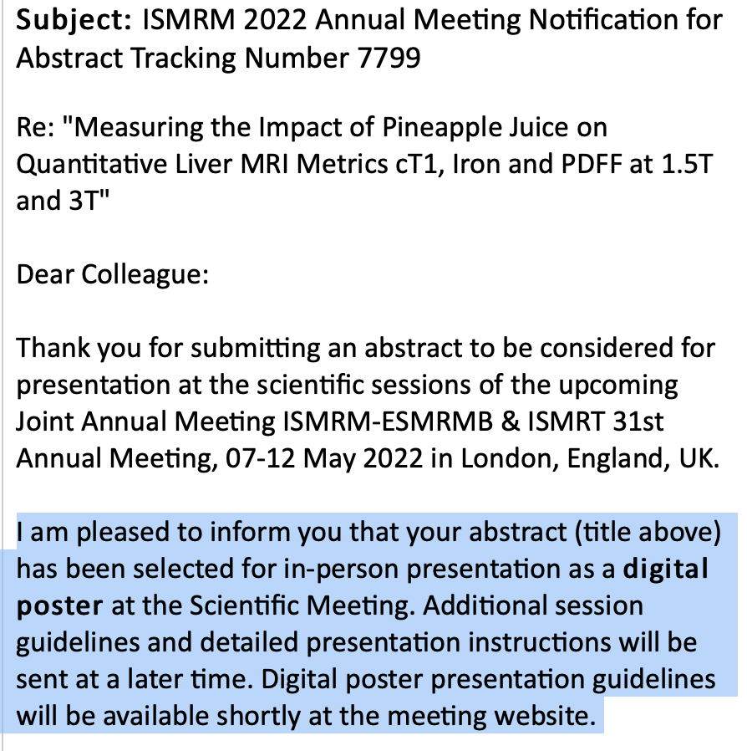

Thank you! Here is some fun fact and good news🍍
Notes:
A tell from pineapple juice
In this talk I will share the little analysis we did with previous performance testing data where we look at:
Whether the pineapple juice ingested by participants for MRCP have an impact on the cT1 values?
The findings help us reduce unintended potential variabilities in our quantifications and gave us confidence on changing the order of our image acquisition protocols.

Slide 25
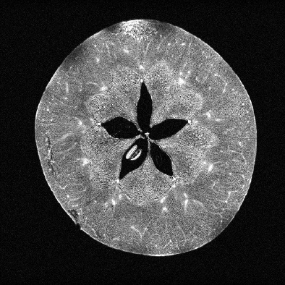
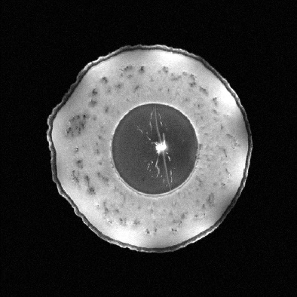













Apple
Avocado
Cabbage
Fig
Kiwi
Passion Fruit
Peach
Pear
Persimon
Plum
Strawberry
Tomato
Pomegranate
Orange
Pumpkin

Slide 26
Limitation 3 Inhomogeneous participant
Outlier 1: Case EXP010_011, age 34, BMI 35.92 (kg/m²)
3T
cT1
T2*
PDFF
Pre
Post
Notes:
For case EXP010_011, the cT1 metrics exceed the healthy reference range by 329.0 and 350.0 (ms); the PDFF metrics exceed the healthy reference range by 15.4 and 15.4 (%) before and after pineapple juice ingestion respectively.

Slide 27
Limitation 3 Inhomogeneous participant
Outlier 2: Case EXP010_019, Age 57, BMI 27.99 kg/m²
3T
cT1
T2*
PDFF
Pre
Post
Notes:
For case EXP010_019, the iron metrics exceed the healthy reference range by 0.7 and 0.9 (mg/g) before and after pineapple juice ingestion respectively. The higher the iron concentration, the lower the T2* value.

Slide 28
Limitation 3 Inhomogeneous participant
Outlier 3: Case EXP010_030, Age 39.0, BMI 28.66 kg/m²
1.5T
cT1
T2*
PDFF
Pre
Post
Notes:
Tunnicliffe E. Evaluating liver fibrosis in the presence of elevated iron using MR relaxometry. In: UK Provisional Patent No. 1304728.7 filed on 15th March; 2013.
Provided the quantification of iron from T2*

Slide 29






Conclusion
Phew
The effect on liver cT1 introduced by pineapple juice is neglectable given the found larger measurement uncertainty (repeatability)
3T
cT1
T2*
PDFF
Pre
Post
Notes:
Since the difference between the compared data was whether the participant had ingested pineapple juice before the 2nd scan. We can conclude that the pineapple juice does not affect our cT1, T2* and PDFF quantification. The image with metric maps shows similar color before and after pineapple juice ingestion. The images showed is a representative case (EXP010_021).

Slide 30
Conclusion
Phew
The effect on liver cT1 introduced by pineapple juice is neglectable given the found larger measurement uncertainty (repeatability)
1.5T
cT1
T2*
PDFF
Pre
Post
Notes:
Since the difference between the compared data was whether the participant had ingested pineapple juice before the 2nd scan. We can conclude that the pineapple juice does not affect our cT1, T2* and PDFF quantification. The image with metric maps shows similar color before and after pineapple juice ingestion. The images showed is a representative case (EXP010_016).

Slide 31


















Aero
Boost
Bounty
Crunchie
Curlywurly
Twix
Double-decker
Fudge
Kinder surprise
Kitkat
Lion Bar
Wispa
Maltesers
Mars
Reeses
Snickers
Twirl
Yorkie

Slide 32

Shapiro Wilk Test

Slide 33

Water’s effect

Slide 34
Method:
Data: 2018 R&R study for LMS and MRPC+ performance testing
Scanner Manufacturer | Model | Field Strength | Site | Acquisition
Siemens | Prisma | 3T | OCMR, Oxford | 2 scans (on-off-on)
Siemens | Avantofit | 1.5 T | OCMR, Oxford | 2 scans (on-off-on)
20 healthy volunteer
10 w/ hepatobiliary condition
10 w/ liver condition
Notes:
loadAndProcessWithAutomation.m run batch analysis overnight
Ask Arun how long it take to analyse 80 data sets
We have this data
But in order to get the report of these data, wait
We want to make use of what we have
Pre automation time, It would have taken 10 hrs of resource, it now took us 2.
80 hrs DA

Slide 35
Method:
Automatic processing overnight with LMS Dv5 (thanks to João)
Data visualization, paired t-test and compare with LMS performance testing
60 hr
2 hr
15 healthy
7 w/ liver condition
8 w/ hepatobiliary condition
Notes:
loadAndProcessWithAutomation.m run batch analysis overnight
Auto analysis -> review report -> and now the data is available at the portal!
Ask Arun how long it take to analyse 80 data sets
We have this data
But in order to get the report of these data, wait
We want to make use of what we have
Pre automation time, It would have taken 10 hrs of resource, it now took us 2.
80 hrs DA

Slide 36

Motivation
💡our devices can interchangeably provide insights of measurements!💡
Does the pineapple juice affect your cT1?
Notes:
Simple question: Does Pineapple juice effect the cT1 - We should know
We asked around, as far as we could go, digged out any report or document on MRCP but there wasn't anything
We found out the data was never analysed, which makes sense that we don't have the answer
This is not on anyone's list right now, how can we answer this min resource as possible?
We had our first study that had MRCP and cT1 acquisition in the protocol.
The customers asked the simple question of : We thought there was an answer, turns out there isn't
The data has been acquired but never analysed !
We had the chance to take advantage of our automatic pipeline, the investigation was done with min resource involvement
Does the pineapple juice change the biomarkers in relations to the recommended reference range?
Do we have a way to rule out the difference is because of measurement error?\
Children 5-15
A selection of image method
They have MRCP + LMS
We had not have this combination before
We want to work out
You would expect we know the answer
We dig out
But unfortunately, we acquired data bur never did the analysis
But thankfully,

Slide 37

Example Report

Slide 38


Findings
Two types of paired test:
Wilcoxon signed-rank test
paired sample T test
Notes:
Strictly speaking because the cT1 datasets failed Shapiro Wilk test, therefore the samples were not normally distributed.
In this case we should run Wilcoxon signed-rank test
However, given the fact that the histogram and box plot showed near normal distributions,
I also ran a 2-tailed paired sample t test and found that the cT1 difference does showed that the that cT1 (Post PJ) is greater than the cT1 (Pre PJ) with statistical confidence.
The mean values are 740.6 ms (Post PJ) and 725.0 ms (Pre PJ) and the df = 58
This then give us some concern and we want to rule out that whether the difference come from measurement error.
Df = 58

Slide 39

Findings
In order to rule out the difference is because of measurement error
Compare with existing performance testing data for LMSv3
Notes:
Repeatability: the same measurement under the same set of conditions within a short period of time
Reproducibility: the same measurement under different measurement conditions.
Note that the number of test sample is different

Slide 40


cT1 Segmentation Repeatability

Slide 41


Iron vs T2* DIXON ROI Repeatability
Note that there is addition variable: the PJ data quantify the T2* values of a whole segmented liver but LMS performance testing data quantified T2* values of ROIs

Slide 42


IDEAL PDFF Segmentation Repeatability

Slide 43

Findings
Does the pineapple juice change the biomarkers in relations to the recommended reference range?
Notes:
4 out of 30 pre-PJ cases (subject 2, 3, 6, 8) showed cT1 value beyond the healthy reference interval. 6 out of 30 post-PJ cases (subject 2, 3, 6, 8, 19, 27) showed cT1 value beyond the healthy reference interval
At both time points, one case (subject 16) showed beyond normal Iron concentration.

Slide 44

Findings
Does the pineapple juice change the biomarkers in relations to the recommended reference range?
Notes:
4 out of 30 pre-PJ cases (subject 1, 8, 27, 38) showed PDFF concentrations higher than normal range.

Slide 45

Findings
Does the pineapple juice change the biomarkers in relations to the recommended reference range?
Notes:
3 out of 30 post-PJ cases (subject 8, 27, 38) showed PDFF concentrations higher than normal range.
With just this, we can’t conclude that PJ gave the effect to cause these value being out of range

Slide 46


Slide 47


Slide 48


Slide 49
Notes:
Let’s take some time to have a deeper look

Slide 51
Notes:
So yeah this tells us we can have a very similar mean but a big difference across each 2 paired measurement

